Slide 1

learning a reward function for the goal states where context is taken into account.
Presented by Rabnawaz Jan Sher
Research Project

Slide 2
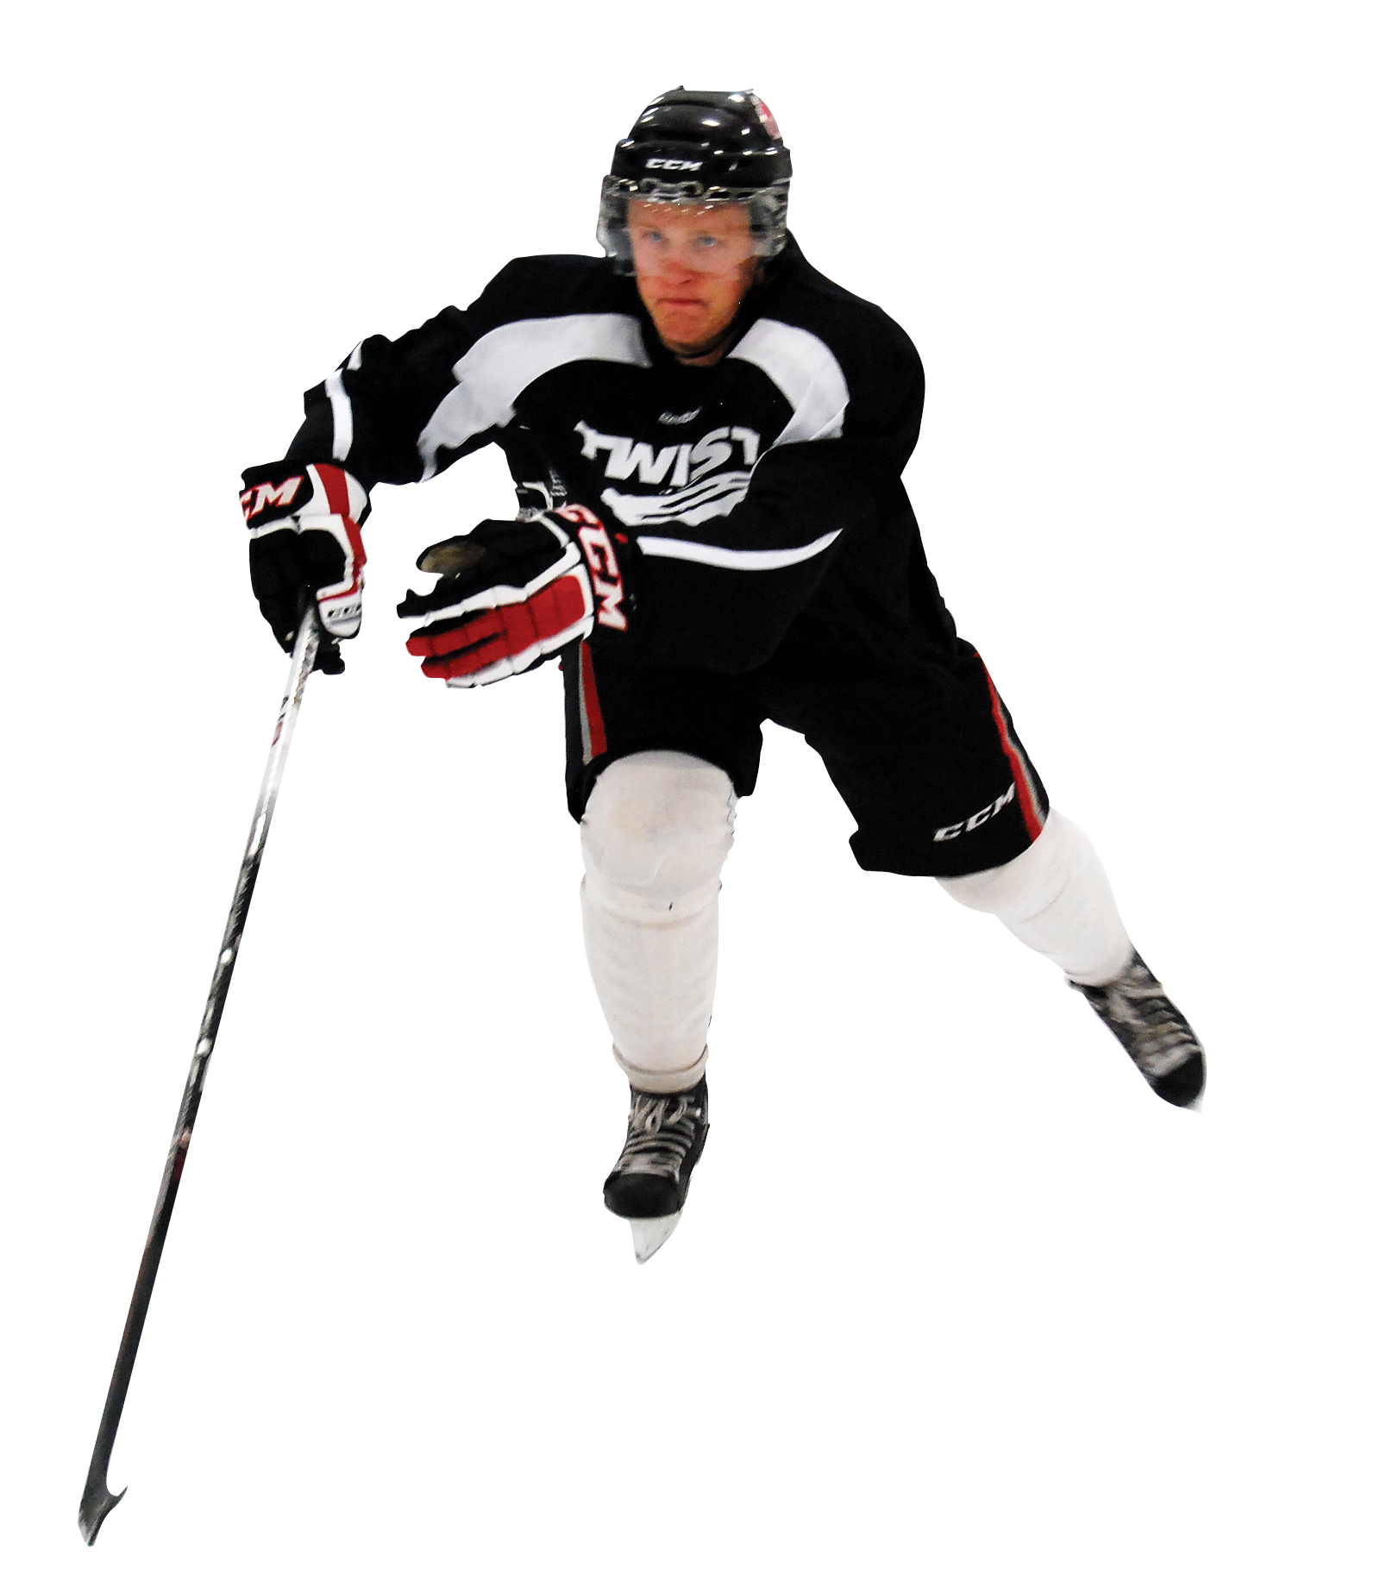

Contents
Background
Introduction
Problem Statement
Solution & result
Conclusion
Future Work
Research Project
Notes:
https://pngimg.com/download/26524

Slide 3
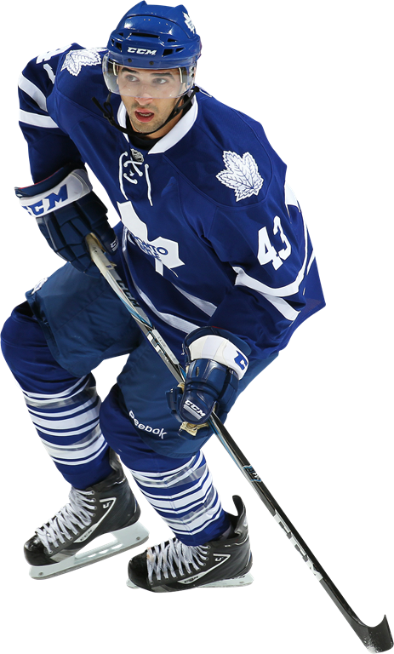
Background
Performance of player impacts directly on Outcome of game in any sport. Thus performance of player in ice hockey is being analyzed by many researchers;
Performance of players in ice hockey is often measured using traditional metrics. [Macdonald,2011].
Introducing more advanced metrics. [Lambrix 2019].
Performance of player when on ice. [Schuckers and Curro 2013]
Pair wise player performance. [Lambrix 2018].
Sources:
Image ref: http://pngimg.com/download/26505
Research Project
Notes:
In the field of sports analytics, researches have been conducted to analyse the performance of player. Since the focus of our research is ice hockey, I would like to highlight few researches conducted in the relevant field.
Introducing more advanced metrics. [Lambrix 2019].

Slide 4
Contents
Background
Introduction
Problem Statement
Solution & result
Conclusion
Future Work
Research Project

Slide 5
Introduction
In sports analytics, work is extensively being done for predicting the outcome of a game as well as for evaluating the performance of a player. Many researches are being done using different techniques.
Example: Deep learning, reinforcement learning
Which technique can prove to be more beneficial?
Reinforcement learning is considered to be a good solution.
What is Reinforcement learning?
Area of machine learning.
Working: Maximizing the reward on the basis of suitable/relevant action taken.
How reinforcement learning is used in sports analytics (of ice hockey)?
The phenomenon of maximization of reward is utilized by creating a Q-function which determines the reward of taking action in a particular state.
Sources:
Image ref: http://pngimg.com/download/26505
Research Project
Notes:
https://www.swehockey.se/Hockeyakademin/Nyheter1/nyheterfranhockeyakademin/NHL-special/NHL-Specialdel14-GabrielLandeskog/

Slide 6
Contents
Background
Introduction
Problem Statement
Solution & result
Conclusion
Future Work
Research Project

Slide 7
Problem Statment
As mentioned earlier Q- value function is being used for evaluating the performance of player in ice hockey.
Reward function is used for learning a Q-value function.
What is Reward function?
A reward function is generally a weightage rewarded whenever a goal is scored.
It was formerly always given as 1 for every goal scored.
What was the problem in it?
Context was not taken into account.
Sources:
Image ref: http://pngimg.com/download/26505
Research Project
Notes:
https://www.swehockey.se/Hockeyakademin/Nyheter1/nyheterfranhockeyakademin/NHL-special/NHL-Specialdel14-GabrielLandeskog/
Notes like :
The situation when goal is scored. i.e like when game is tie and on the last momment player score a goal is more reward weightabge or value when one team is already wininng by lead

Slide 8
Contents
Background
Introduction
Problem Statement
Solution & result
Conclusion
Future Work
Research Project

Slide 9
Solution
In this research, we have taken the context of goals into account.
What was the scenario when goal is scored and when was the goal scored?
That is:
Goal difference at the time of goal scored.
Manpower difference at the time of goal scored.
Time when the goal was scored.
Time when goal is scored.
Giving weightage if goal is scored in the beginning of time interval.i.e Method-1
Giving weightage if goal is scored at the end of time interval.i.e Method-2.
Sources:
Image ref: http://pngimg.com/download/26505
Research Project
Notes:
https://www.swehockey.se/Hockeyakademin/Nyheter1/nyheterfranhockeyakademin/NHL-special/NHL-Specialdel14-GabrielLandeskog/
Notes like :
The situation when goal is scored. i.e like when game is tie and on the last momment player score a goal is more reward weightabge or value when one team is already wininng by lead

Slide 10
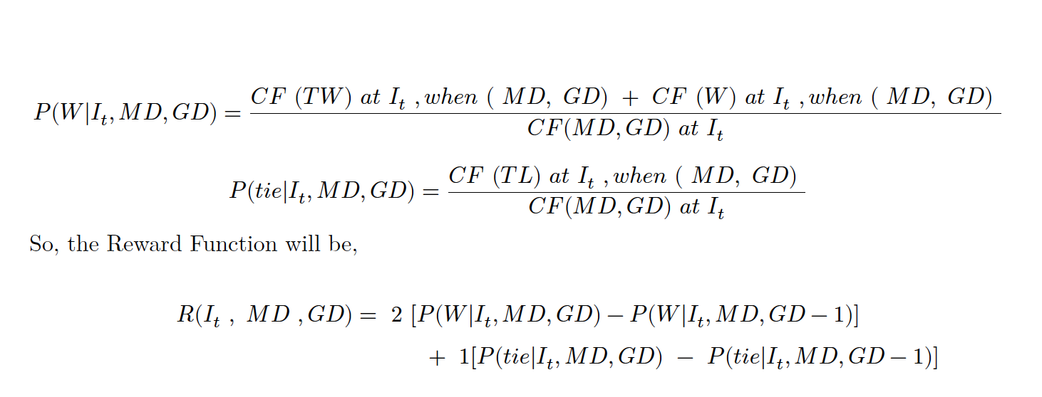
Cont..
We have used different methods for forming time intervals.
Fixed time intervals (by fixed difference).
Dynamic time interval (based on provided vector).
Reward Function for this research:
Sources:
Image ref: http://pngimg.com/download/26505
Research Project
Notes:
https://www.swehockey.se/Hockeyakademin/Nyheter1/nyheterfranhockeyakademin/NHL-special/NHL-Specialdel14-GabrielLandeskog/
Notes like :
The situation when goal is scored. i.e like when game is tie and on the last momment player score a goal is more reward weightabge or value when one team is already wininng by lead

Slide 11
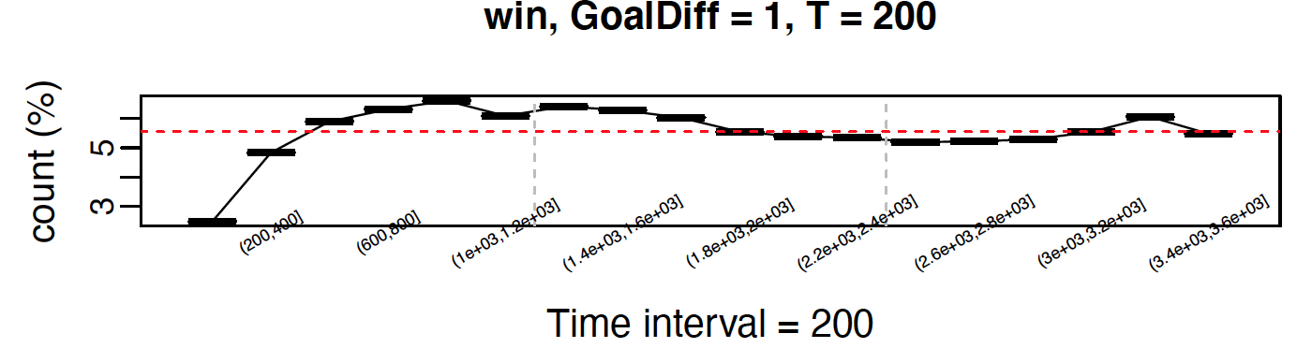
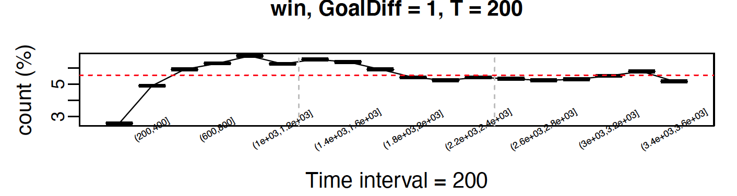
Result (fixed time interval)
Method 1:
Method 2:
Sources:
Image ref: http://pngimg.com/download/26505
Research Project
Notes:
https://www.swehockey.se/Hockeyakademin/Nyheter1/nyheterfranhockeyakademin/NHL-special/NHL-Specialdel14-GabrielLandeskog/
Notes like :
The situation when goal is scored. i.e like when game is tie and on the last momment player score a goal is more reward weightabge or value when one team is already wininng by lead

Slide 12
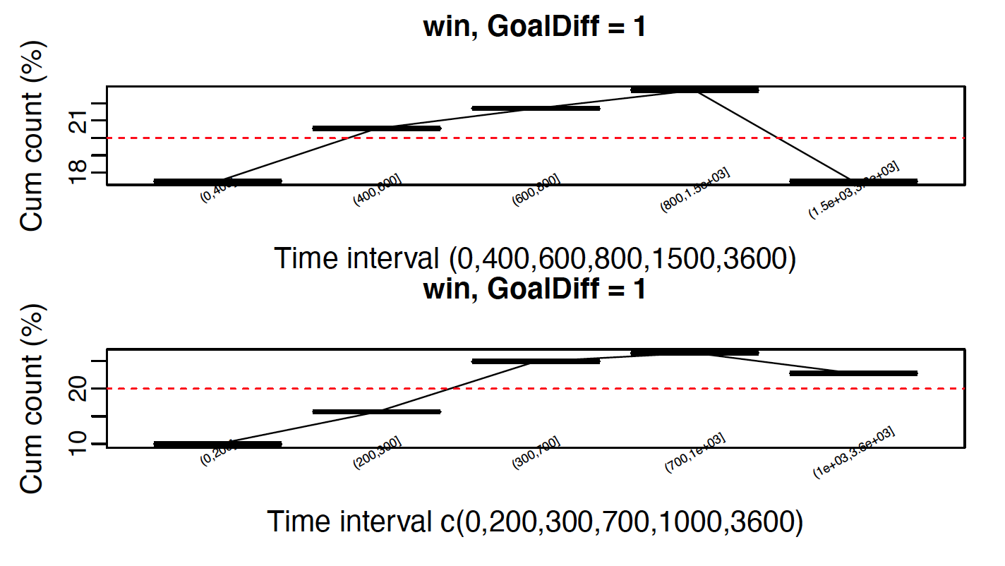
Result (user defined interval)
Method 1:
Sources:
Image ref: http://pngimg.com/download/26505
Research Project
Notes:
https://www.swehockey.se/Hockeyakademin/Nyheter1/nyheterfranhockeyakademin/NHL-special/NHL-Specialdel14-GabrielLandeskog/
Notes like :
The situation when goal is scored. i.e like when game is tie and on the last momment player score a goal is more reward weightabge or value when one team is already wininng by lead

Slide 13
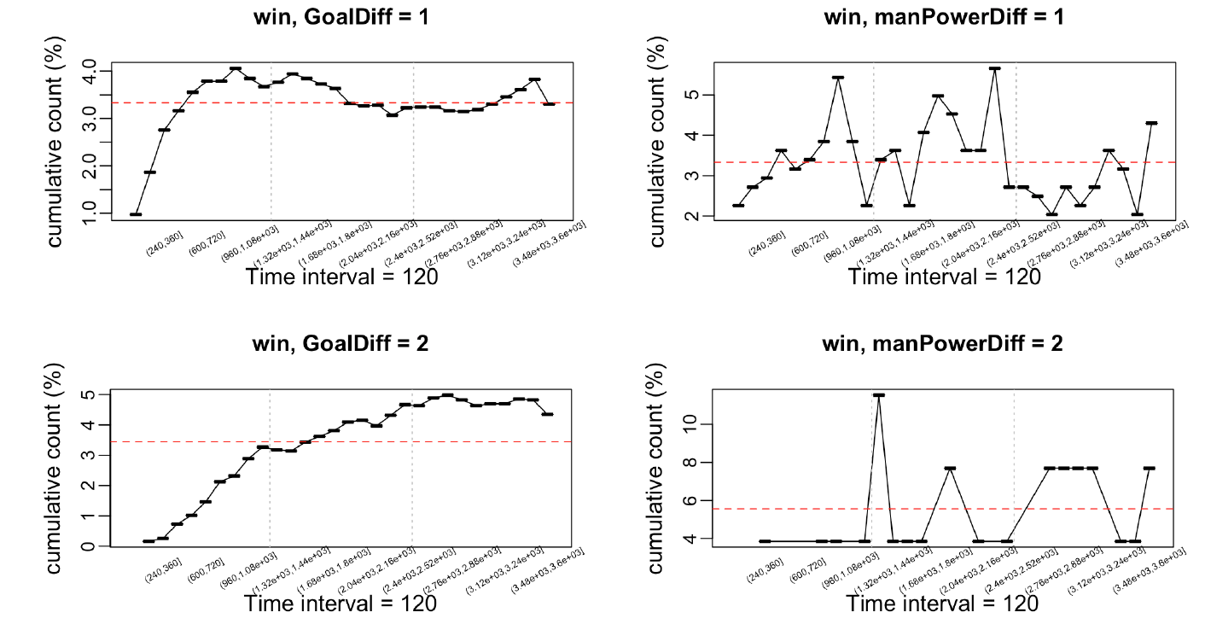
Result (Goal & ManPower Difference)
Sources:
Image ref: http://pngimg.com/download/26505
Research Project
Notes:
https://www.swehockey.se/Hockeyakademin/Nyheter1/nyheterfranhockeyakademin/NHL-special/NHL-Specialdel14-GabrielLandeskog/
Notes like :
The situation when goal is scored. i.e like when game is tie and on the last momment player score a goal is more reward weightabge or value when one team is already wininng by lead

Slide 14
Contents
Background
Introduction
Problem Statement
Solution & result
Conclusion
Future Work
Research Project

Slide 15
Conclusion
The trend is almost same for fixed intervals though trend is more visible for the user defined intervals as the intervals can be small or big in this case.
From the plots as well as from the table in section 4.5, it can be observed that there is not much difference in outcome using Method 1 or Method 2. The outcomes are almost same.
Table: 4.5
Sources:
Image ref: http://pngimg.com/download/26505
Research Project
Notes:
https://www.swehockey.se/Hockeyakademin/Nyheter1/nyheterfranhockeyakademin/NHL-special/NHL-Specialdel14-GabrielLandeskog/
Notes like :
The situation when goal is scored. i.e like when game is tie and on the last momment player score a goal is more reward weightabge or value when one team is already wininng by lead

Slide 16
Contents
Background
Introduction
Problem Statement
Solution & result
Conclusion
Future Work
Research Project

Slide 17
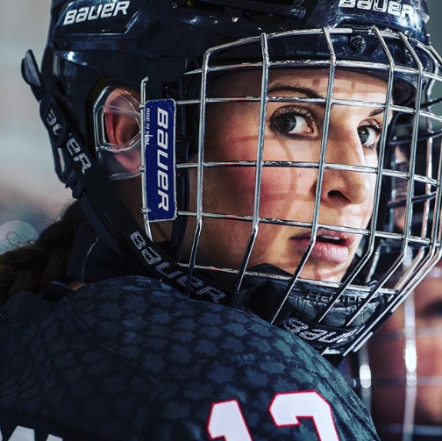
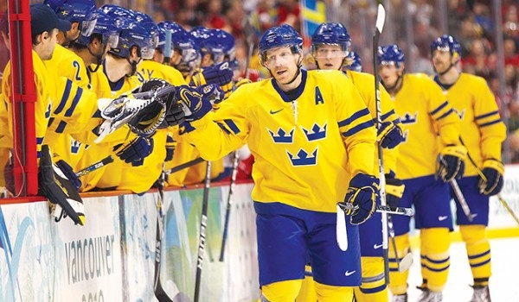
Future Work
Regarding future is to use this reward function (Generates reward Matrix) in the Q-learning algorithm to investigate impact of player actions for different desirable outcomes.
Sources:
Image ref: http://pngimg.com/download/26505
Research Project
Notes:
https://whatsupusana.com/2019/09/meaghan-mikkelson-getting-real-on-the-ice/

Slide 18
Questions or Feedback
Sources:
Image ref: http://pngimg.com/download/26505
Research Project
Notes:
https://whatsupusana.com/2019/09/meaghan-mikkelson-getting-real-on-the-ice/

Slide 19

Rabnawaz Jan Sher
732A76 Research Project rabsh696@student.liu.se

